Slide 1

Learning
Chapter 5

Slide 2
Chapter 5 Learning Objective Menu
LO 5.1 Learning
LO 5.2 Classical conditioning and who first studied it
LO 5.3 Important concepts in classical conditioning
LO 5.4 Pavlov’s classic experiment in conditioning
LO 5.5 Conditioned emotional response
LO 5.6 Why classical conditioning works
LO 5.7 Operant conditioning and Thorndike’s Law of Effect
LO 5.8 Skinner’s contribution to operant conditioning
LO 5.9 Important concepts in operant conditioning
LO 5.10 Schedules of reinforcement
LO 5.11 How punishment affects behavior
LO 5.12 How operant stimuli control behavior
LO 5.13 Kind of behavior resistant to conditioning
LO 5.14 Behavior modification
LO 5.15 Neurofeedback and how it is used
LO 5.16 Cognitive learning theory
LO 5.17 Tolman’s classic study on latent learning
LO 5.18 Learned helplessnes
LO 5.19 Insight
LO 5.20 Observational learning
LO 5.21 Bandura’s classic Bobo doll study
LO 5.22 Four elements of observational learning
LO 5.23 Real world example of use of conditioning

Slide 3
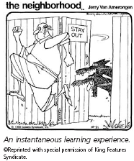
What is Learning?
LO 5.1 Learning
Learning – any relatively permanent change in behavior brought about by experience or practice.
  When people learn anything, some part of their brain is physically changed to record what they have learned.
  Any kind of change in the way an organism behaves is learning.
Menu

Slide 4
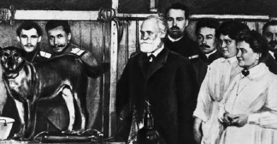
Pavlov and Classical Conditioning
LO 5.2 Classical conditioning and who first studied it
Ivan Pavlov – Russian physiologist (person who studies the workings of the body) who discovered classical conditioning through his work on digestion in dogs.
Classical conditioning - learning to make a reflex response to a stimulus other than the original, natural stimulus that normally produces the reflex.
Menu

Slide 5
Classical Conditioning Concepts
LO 5.3 Important concepts in classical conditioning
Unconditioned stimulus (UCS) - a naturally occurring stimulus that leads to an involuntary response.
  Unconditioned means “unlearned” or “naturally occurring.”
Unconditioned response (UCR) - an involuntary response to a naturally occurring or unconditioned stimulus.
Menu

Slide 6
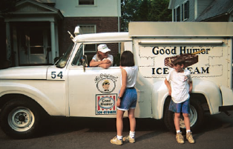
Classical Conditioning Concepts
LO 5.3 Important concepts in classical conditioning
Conditioned stimulus (CS) - stimulus that becomes able to produce a learned reflex response by being paired with the original unconditioned stimulus.
  Conditioned means “learned.”
  A neutral stimulus can become a conditioned stimulus when paired with an unconditioned stimulus.
Conditioned response (CR) - learned reflex response to a conditioned stimulus.
  Sometimes called a conditioned reflex.
CS – ice cream truck
CR – salivation when hear ice cream truck bell
Menu

Slide 7
Classical Conditioning
LO 5.3 Important concepts in classical conditioning
UCS
Loud Noise
UCR
Startle
CS
Bunny Rabbit
UCS
Loud Noise
UCR
Startle
CS
Bunny Rabbit
CR
Startle
Menu

Slide 8
Classical Conditioning
LO 5.3 Important concepts in classical conditioning
UCS
Dog Bite
UCR
Frightened
CS
Sight of Dog
UCS
Dog Bite
UCR
Frightened
CS
Sight of Dog
CR
Frightened
Menu

Slide 9
Classical Conditioning
LO 5.3 Important concepts in classical conditioning
UCS
Car Crash
UCR
Racing Heart
CS
Squealing Brakes
UCS
Car Crash
UCR
Racing Heart
CS
Squealing Brakes
CR
Racing Heart
Menu

Slide 10
Classical Conditioning
LO 5.3 Important concepts in classical conditioning
UCS
Kiss
UCR
Racing Heart
CS
Sight of Significant Other
UCS
Kiss
UCR
Racing Heart
CS
Sight of Significant Other
CR
Racing Heart
Menu

Slide 11
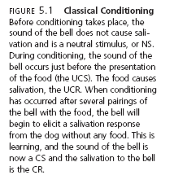
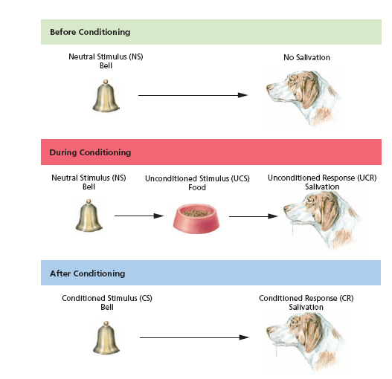
LO 5.4 Pavlov’s classic experiment in conditioning
Acquisition - the repeated
pairing of the NS and the UCS;
the organism is in the process of acquiring learning.
Menu

Slide 12
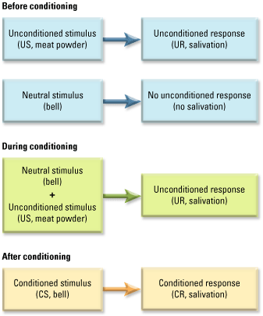
LO 5.4 Pavlov’s classic experiment in conditioning
Menu

Slide 13

Classical Conditioning Concepts
LO 5.4 Pavlov’s classic experiment in conditioning
Although classical conditioning
happens quite easily, there are a
few basic principles that researchers
have discovered:
The CS must come before the UCS.
The CS and UCS must come very close together in time—ideally, only several seconds apart.
The neutral stimulus must be paired with the UCS several times, often many times, before conditioning can take place.
The CS is usually some stimulus that is distinctive or stands out from other competing stimuli.
Menu

Slide 14
Classical Conditioning Concepts
LO 5.4 Pavlov’s classic experiment in conditioning
Stimulus generalization - the tendency to respond to a stimulus that is only similar to the original conditioned stimulus with the conditioned response.
Stimulus discrimination - the tendency to stop making a generalized response to a stimulus that is similar to the original conditioned stimulus because the similar stimulus is never paired with the unconditioned stimulus.
Extinction - the disappearance or weakening of a learned response following the removal or absence of the unconditioned stimulus (in classical conditioning) or the removal of a reinforcer (in operant conditioning).
Menu

Slide 15
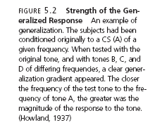
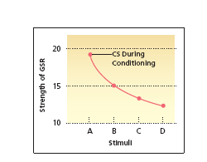
LO 5.4 Pavlov’s classic experiment in conditioning
Menu

Slide 16
Classical Conditioning Concepts
LO 5.4 Pavlov’s classic experiment in conditioning
Reinforcer - any event or object that, when following a response, increases the likelihood of that response occurring again.
Spontaneous recovery – the reappearance of a learned response after extinction has occurred.
  Learning is a relatively permanent change in behavior.
Higher-order conditioning - occurs when a strong conditioned stimulus is paired with a neutral stimulus, causing the neutral stimulus to become a second conditioned stimulus.
Menu

Slide 17
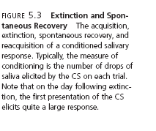
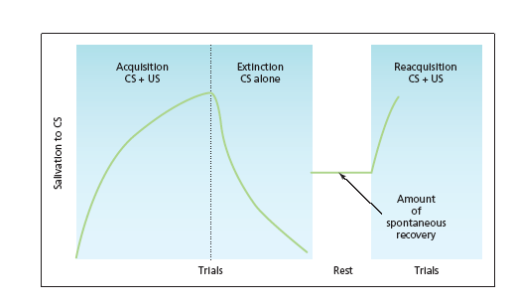
LO 5.4 Pavlov’s classic experiment in conditioning
Menu

Slide 18
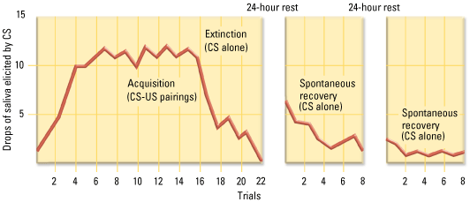
LO 5.4 Pavlov’s classic experiment in conditioning
Menu

Slide 19
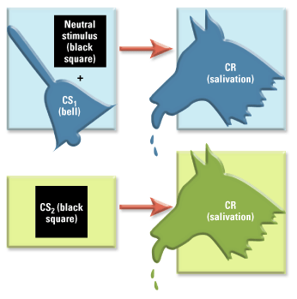
LO 5.4 Pavlov’s classic experiment in conditioning
Higher order conditioning.
Menu

Slide 20
Conditioned Emotional Response
LO 5.5 Conditioned emotional response
Conditioned emotional response (CER) - emotional response that has become classically conditioned to occur to learned stimuli, such as a fear of dogs or the emotional reaction that occurs when seeing an attractive person.
  CERs may lead to phobias – irrational fear responses.
Menu

Slide 21
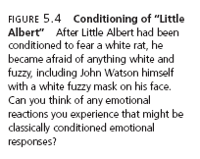
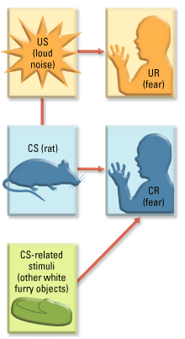
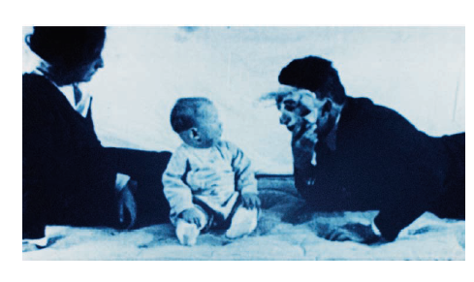
LO 5.5 Conditioned emotional response
Menu

Slide 22
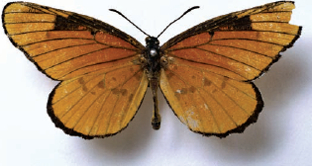
Taste Aversion
LO 5.5 Conditioned emotional response
Vicarious conditioning - classical conditioning of a reflex response or emotion by watching the reaction of another person.
Conditioned taste aversion - development of a nausea or aversive response to a particular taste because that taste was followed by a nausea reaction, occurring after only one association.
        Biological preparedness - the tendency of animals to learn certain associations, such as taste and nausea, with only one or few pairings due to the survival value of the learning.
Menu

Slide 23
Why Classical Conditioning Works
LO 5.6 Why classical conditioning works
Stimulus substitution - original theory in which Pavlov stated that classical conditioning occurred because the conditioned stimulus became a substitute for the unconditioned stimulus by being paired closely together.
Cognitive perspective - modern theory in which classical conditioning is seen to occur because the conditioned stimulus provides information or an expectancy about the coming of the unconditioned stimulus.
Menu

Slide 24
Operant Conditioning
LO 5.7 Operant conditioning and Thorndike’s law of effect
Operant conditioning - the learning of voluntary behavior through the effects of pleasant and unpleasant consequences to responses.
Thorndike’s Law of Effect - law stating that if a response is followed by a pleasurable consequence, it will tend to be repeated, and if followed by an unpleasant consequence, it will tend not to be repeated.
Menu

Slide 25
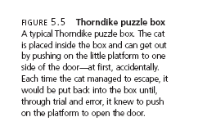
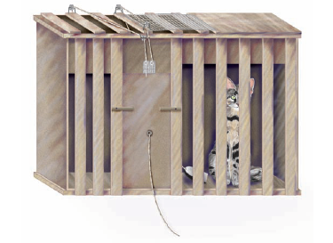
LO 5.7 Operant conditioning and Thorndike’s law of effect
Menu

Slide 26
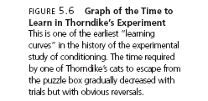
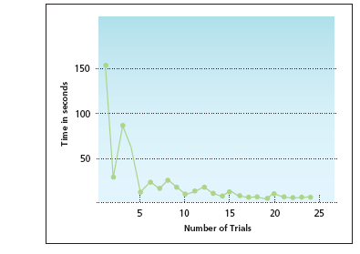
LO 5.7 Operant conditioning and Thorndike’s law of effect
Menu

Slide 27
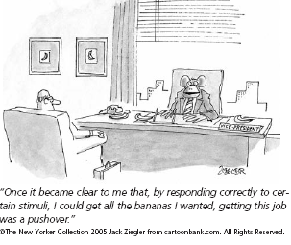
Skinner’s Contribution
LO 5.8 Skinner’s contribution to operant conditioning
Behaviorist; wanted to study only observable, measurable behavior.
Gave “operant conditioning” its name.
  Operant - any behavior that is voluntary.
Learning depends on what happens after the response — the consequence.
Menu

Slide 28
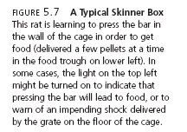
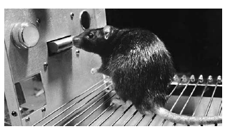
LO 5.8 Skinner’s contribution to operant conditioning
Menu

Slide 29
Reinforcement
LO 5.9 Important concepts in operant conditioning
Reinforcement - any event or stimulus, that when following a response, increases the probability that the response will occur again.
  Primary reinforcer - any reinforcer that is naturally reinforcing by meeting a basic biological need, such as hunger, thirst, or touch.
  Secondary reinforcer - any reinforcer that becomes reinforcing after being paired with a primary reinforcer, such as praise, tokens, or gold stars.
Menu

Slide 30
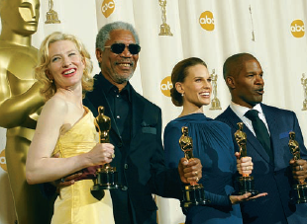
Positive and Negative Reinforcement
LO 5.9 Important concepts in operant conditioning
Positive reinforcement - the reinforcement of a response by the addition or experiencing of a pleasurable stimulus.
Negative reinforcement - the reinforcement of a response by the removal, escape from, or avoidance of an unpleasant stimulus.
Example: Taking aspirin for a headache is negatively reinforced – removal of headache!
Menu

Slide 31
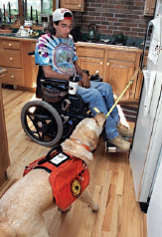
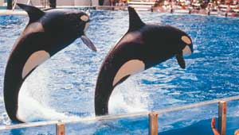
Shaping
LO 5.9 Important concepts in operant conditioning
Shaping - the reinforcement of simple steps in behavior that lead to a desired, more complex behavior.
  Successive approximations - small steps in behavior, one after the other, that lead to a particular goal behavior.
Menu

Slide 32
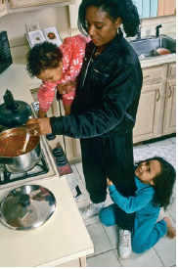
Other Classical Conditioning Concepts
LO 5.9 Important concepts in operant conditioning
Extinction – occurs if the behavior (response) is not reinforced.
Operantly conditioned responses also can be generalized to stimuli that are only similar to the original stimulus.
Spotaneous recovery (reoccurrence of a once extinguished response) also happens in operant conditioning.
One way to deal with a child’s temper
tantrum is to ignore it. The lack of
reinforcement for the tantrum behavior
will eventually result in extinction.
Menu

Slide 33
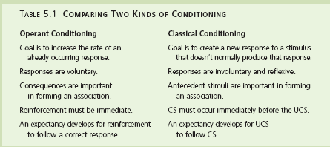
LO 5.9 Important concepts in operant conditioning
Menu

Slide 34
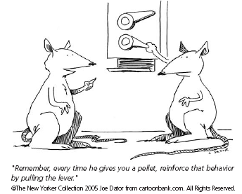
Schedules of Reinforcement
LO 5.10 Schedules of reinforcement
Partial reinforcement effect - the tendency for a response that is reinforced after some, but not all, correct responses to be very resistant to extinction.
Continuous reinforcement - the reinforcement of each and every correct response.
Menu

Slide 35

Schedules of Reinforcement
LO 5.10 Schedules of reinforcement
Fixed ratio schedule of reinforcement - schedule of reinforcement in which the number of responses required for reinforcement is always the same.
Variable ratio schedule of reinforcement - schedule of reinforcement in which the number of responses required for reinforcement is different for each trial or event.
Menu

Slide 36

Schedules of Reinforcement
LO 5.10 Schedules of reinforcement
Fixed interval schedule - of reinforcement schedule of reinforcement in which the interval of time that must pass before reinforcement becomes possible is always the same.
Variable interval schedule of reinforcement - schedule of reinforcement in which the interval of time that must pass before reinforcement becomes possible is different for each trial or event.
Menu

Slide 37

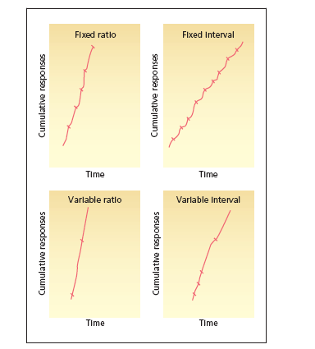
LO 5.10 Schedules of reinforcement
Menu

Slide 38
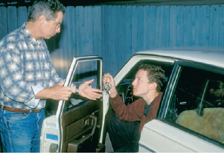
Punishment
LO 5.11 How punishment affects behavior
Punishment - any event or object that, when following a response, makes that response less likely to happen again.
Punishment by application - the punishment of a response by the addition or experiencing of an unpleasant stimulus.
Punishment by removal - the punishment of a response by the removal of a pleasurable stimulus.
Menu

Slide 39
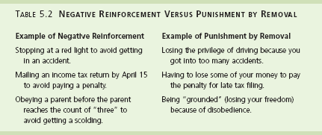
LO 5.11 How punishment affects behavior
Menu

Slide 40
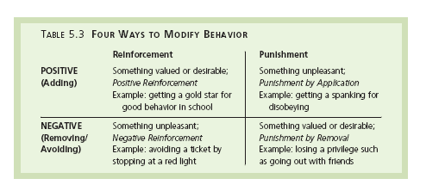
LO 5.11 How punishment affects behavior
Menu

Slide 41
How to Make Punishment More Effective
LO 5.11 How punishment affects behavior
Punishment should immediately follow the behavior it is meant to punish.
Punishment should be consistent.
Punishment of the wrong behavior should be paired, whenever possible, with reinforcement of the right behavior.
Menu

Slide 42
Operant Stimuli and Stimulus Control
LO 5.12 How operant stimuli control behavior
Discriminative stimulus - any stimulus, such as a stop sign or a doorknob, that provides the organism with a cue for making a certain response in order to obtain reinforcement.
Menu

Slide 43
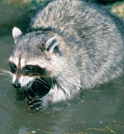
Behavior Resistant to Conditioning
LO 5.13 Kind of behavior resistant to conditioning
Instinctive drift - tendency for an animal’s behavior to revert to genetically controlled patterns.
  Each animal comes into the world (and the laboratory) with certain genetically determined instinctive patterns of behavior already in place.
  These instincts differ from species to species.
  There are some responses that simply cannot be trained into an animal regardless of conditioning.
Raccoons commonly dunk their food in
and out of water before eating. This
“washing” behavior is controlled by
instinct and difficult to change even
using operant techniques.
Menu

Slide 44
Behavior Modification
LO 5.14 Behavior modification
Behavior modification - the use of operant conditioning techniques to bring about desired changes in behavior.
Token economy - type of behavior modification in which desired behavior is rewarded with tokens.
Time-out - a form of mild punishment by removal in which a misbehaving animal, child, or adult is placed in a special area away from the attention of others.
  Essentially, the organism is being “removed” from any possibility of positive reinforcement in the form of attention.
Applied behavior analysis (ABA) – modern term for a form of behavior modification that uses shaping techniques to mold a desired behavior or response.
Menu

Slide 45
Biofeedback and Neurofeedback
LO 5.15 Neurofeedback and how its used
Biofeedback- the use of feedback about biological conditions to bring involuntary responses such as blood pressure and relaxation under voluntary control.
Neurofeedback - form of biofeedback using brainscanning devices to provide feedback about brain activity in an effort to modify behavior.
Menu

Slide 46
Cognitive Learning Theory
LO 5.16 Cognitive learning theory
Early days of learning – focus was on behavior.
1950s and more intensely in the 1960s, many psychologists were becoming aware that cognition, the mental events that take place inside a person’s mind while behaving, could no longer be ignored.
Edward Tolman – early cognitive scientist.
Menu

Slide 47
Latent Learning
LO 5.17 Tolman’s classic study on latent learning
Edward Tolman’s best-known experiments in learning involved teaching three groups of rats the same maze, one at a time (Tolman & Honzik, 1930).
  Group 1 – rewarded each time at end of maze.
    Learned maze quickly.
  Group 2 – in maze every day; only rewarded on 10th day.
    Demonstrated learning of maze almost immediately after receiving reward.
  Group 3 – never rewarded.
    Did not learn maze well.
Latent learning - learning that remains hidden until its application becomes useful.
Menu

Slide 48
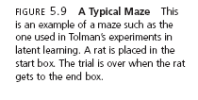
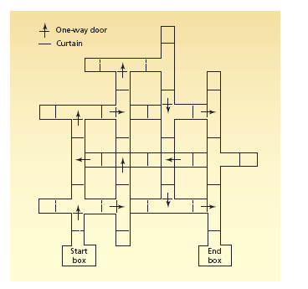
LO 5.17 Tolman’s classic study on latent learning
Menu

Slide 49
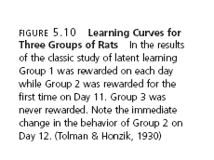
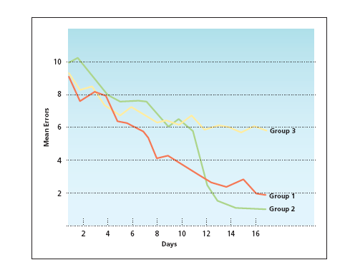
LO 5.17 Tolman’s classic study on latent learning
Menu

Slide 50
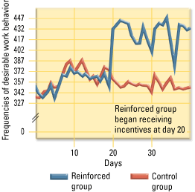
LO 5.17 Tolman’s classic study on latent learning
Another example of latent learning
Menu

Slide 51
Learned Helplessness
LO 5.18 Learned helplessness
Learned helplessness - the tendency to fail to act to escape from a situation because of a history of repeated failures in the past.
Menu

Slide 52
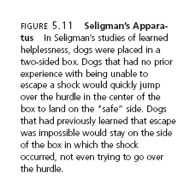
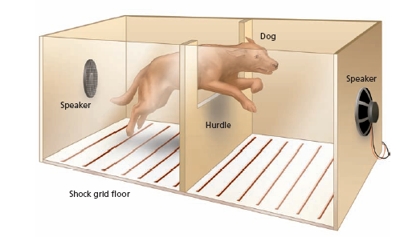
LO 5.18 Learned helplessness
Menu

Slide 53
Insight
LO 5.19 Insight
Insight - the sudden perception of relationships among various parts of a problem, allowing the solution to the problem to come quickly.
  Cannot be gained through trial-and-error learning alone.
  “Aha” moment.
Menu

Slide 54
Observational Learning
LO 5.20 Observational learning
Observational learning - learning new behavior by watching a model perform that behavior.
Learning/performance distinction - referring to the observation that learning can take place without actual performance of the learned behavior.
Menu

Slide 55
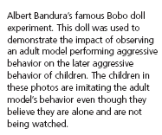
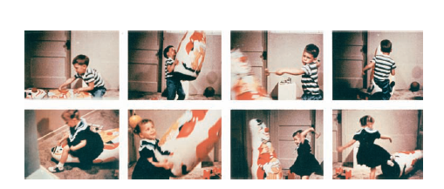
LO 5.21 Bandura’s classic Bobo doll study
Menu

Slide 56
Four Elements of Observational Learning
LO 5.22 Four elements of observational learning
ATTENTION
To learn anything through observation, the learner must first pay attention to the model.
MEMORY
The learner must also be able to retain the memory of what was done, such as remembering the steps in preparing a dish that was first seen on a cooking show.
IMITATION
The learner must be capable of reproducing, or imitating, the actions of the model.
MOTIVATION
Finally, the learner must have the desire to perform the action.
(An easy way to remember the four elements of modeling is to remember the letters AMIM, which stands for the first letters of each of the four elements).
Menu

Slide 57
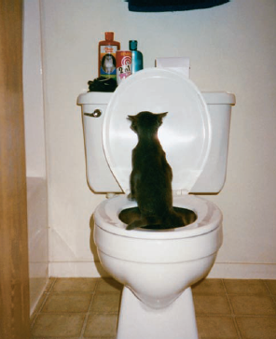
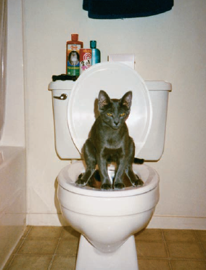
Real World Example
LO 5.23 Real world example use of conditioning
Training a cat to use the toilet will involve:
  Shaping.
  Preparing “the training arena.”
  Positive reinforcement on a variable schedule.
Menu

